Slide 1

Social and Safe
Social Media and Harm Reduction
How to get a bit more control of your online life

Slide 2
Why are we here?

Slide 3

Some things to note...
The companies we will discuss are data firms
The internet wasn’t really made for privacy
Without knowledge of their insides, there is a limit to this advice
Exp. 12/2018

Slide 4

Facebook
Extensions
Data Selfie
Take a look at how FB advertisers sees you
Facebook Container
Allows you to use Firefox without worrying about crossover
Privacy Badger
Blocks trackers across websites

Slide 5
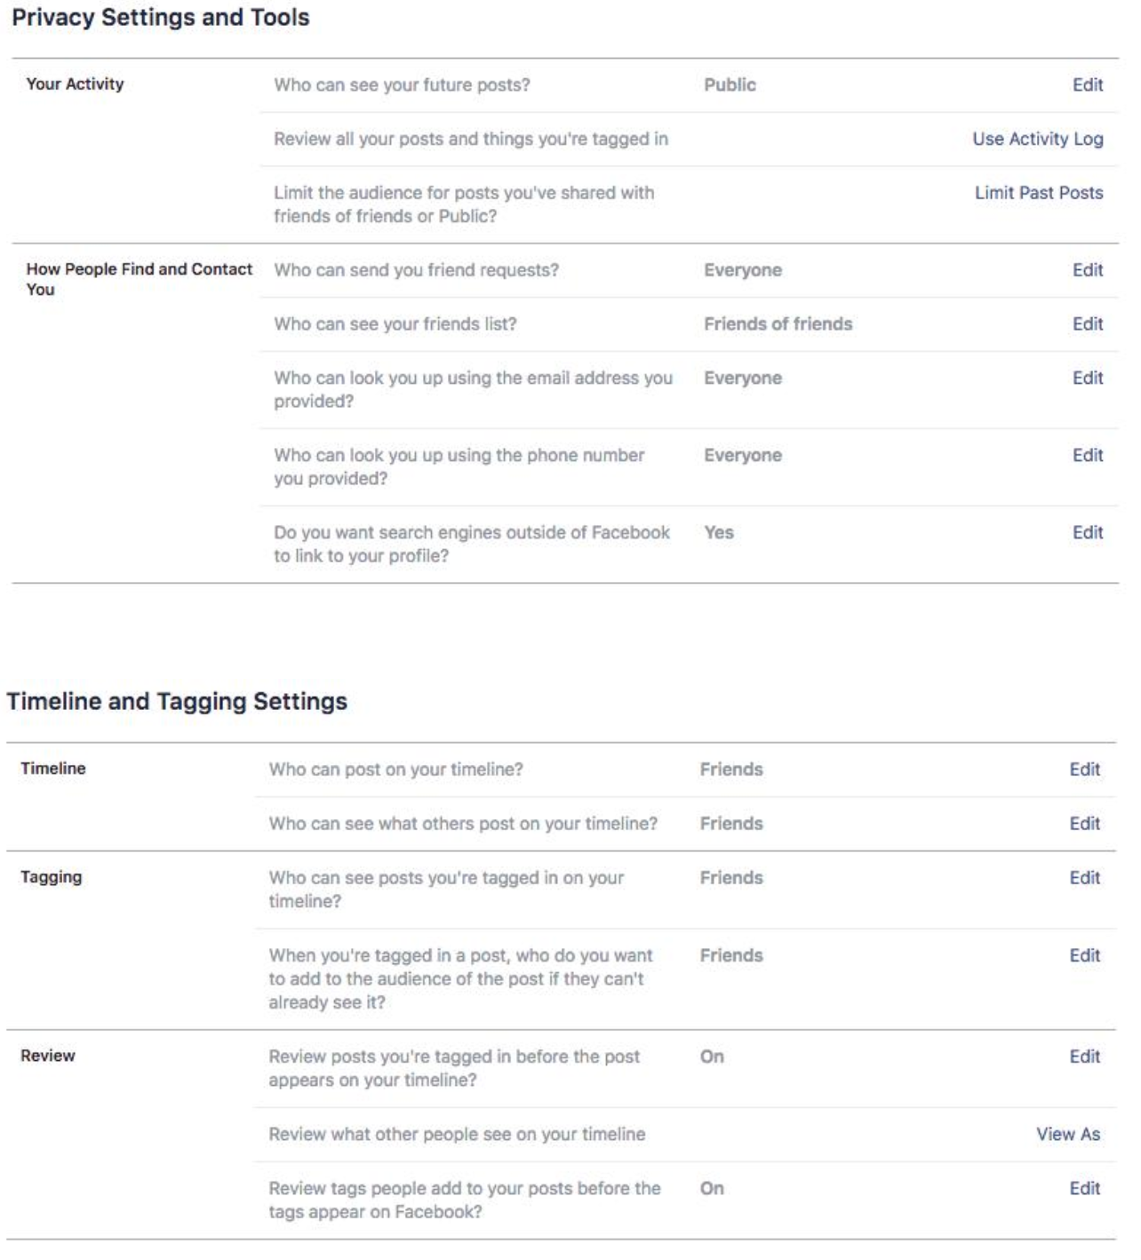
Facebook (contd.)
Privacy Settings
Play around with the privacy section
Turn Off/Edit Apps
Turn Off Ads
Set Timeline/Profile Settings
Friends List
Download your data

Slide 6
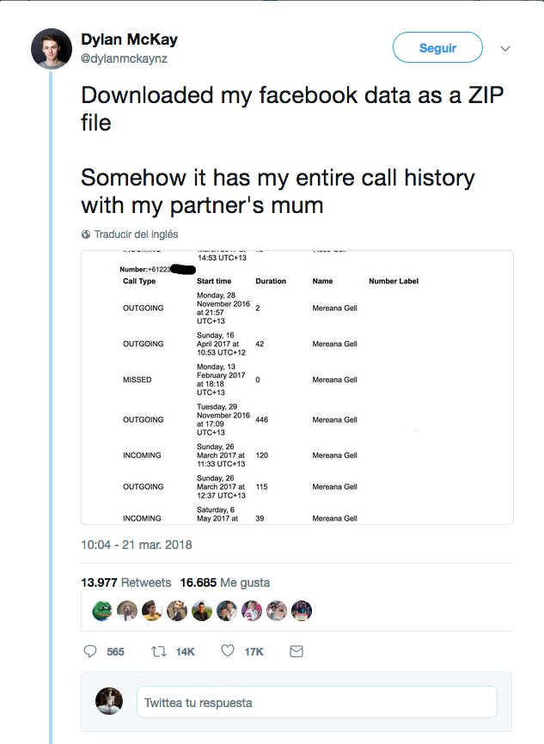
Facebook (contd.)
Mobile
Be aware of permissions you give FB and FB Messenger App
Better to use your phone browser
Contacts
Location
Camera
Storage
Texts
Calls

Slide 7

Facebook (contd.)
Day By Day Tasks
“Tending your Garden”
Delete Posts
Untag Yourself
Delete Friends
Password
Make sure you have a strong passphrase

Slide 8
Navigating Other Platforms
Google
Google yourself!
Google Alternatives
Search: DuckDuck Go
Email: ProtonMail
Browsers: Mozilla, Brave
Productivity: CryptPad
Cloud: Sync, NextCloud
Browsers
Open source
Extensions
Privacy Badger
Ublock Origin
No Script
Apps
Be aware of where you use Facebook/Google login
Be aware of who owns Apps

Slide 9

Further Resources
Me and My Shadow
Motherboard Guide to Using Facebook Safely
New York Times, Want to Purge Your Social Media Timelines?_x0001_
I Just Can't Quit You! Your Privacy Guide to Facebook
Data Detox
Prism Break
Privacytools.io

